Slide 1
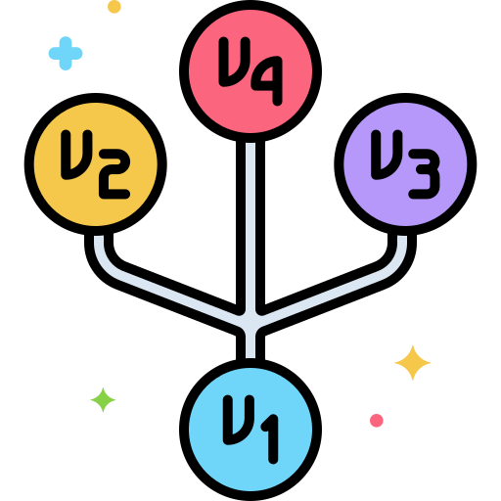



Git Essentials
Version Control System

Slide 2



Yeh hai aam zindagi
Notes:
Joke(Free contributions)

Slide 3
Yeh hai aam zindagi

Slide 4
Yeh hai Mentos zindagi
Notes:
Notice(there is git inside of github)

Slide 5



What is Version Control System?
Version Control System (VCS) is a tool that helps track and manage changes made to files, documents, and code. It allows multiple users to work on the same project simultaneously while keeping track of who made which changes and when.

Slide 6
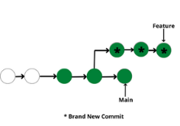
Important points of
What is Version Control System?
Repository :
It can be thought of as a database of changes. It contains all the edits and historical versions (snapshots) of the project.
Copy of Work :
It is the personal copy of all the files in a project. You can edit to this copy, without affecting the work of others and you can finally commit your changes to a repository when you are done making your changes.
Working in Group :
Version control helps you with the, merging different requests to main repository without making any undesirable changes. You may test the functionalities without putting it live, and you don’t need to download and set up each time, just pull the changes and do the changes, test it and merge it back. It may be visualized as.

Slide 7
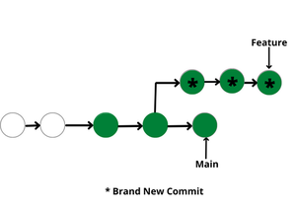

Slide 8
Types
Version Control Systems
Centralized
Decentralized

Slide 9
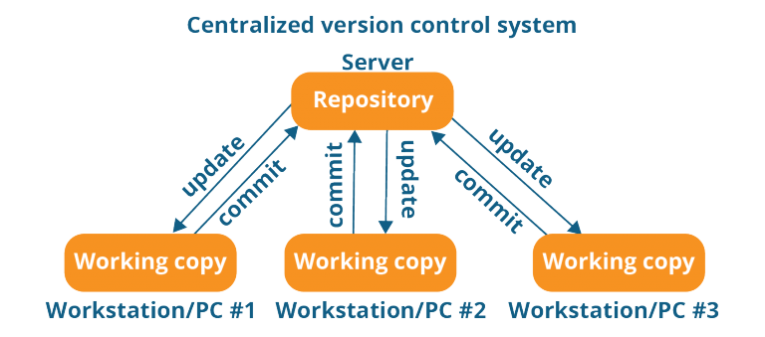
Centralized
Version Control Systems
Centralized
Decentralized
Centralized VCS uses a central server to store all the versions of a project. It allows a single point of control and management of all changes. Examples include Subversion and Perforce.

Slide 10
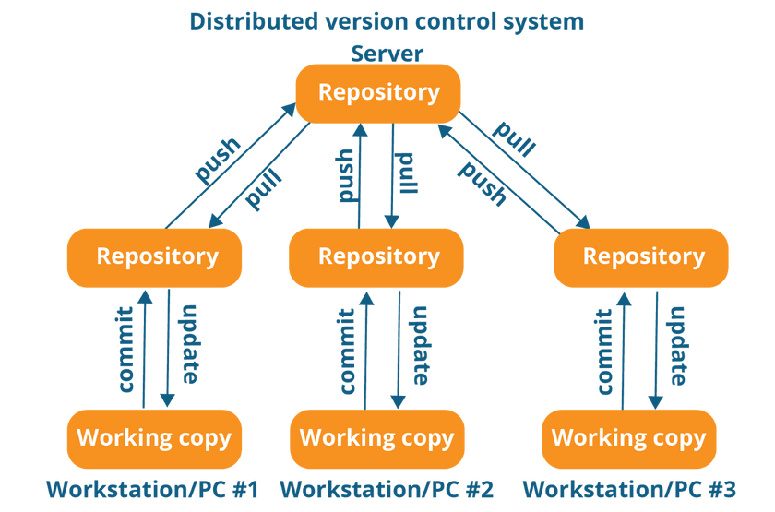

Version Control Systems
Centralized
Decentralized
Decentralized
Distributed VCS, also called decentralized VCS, allows multiple copies of a project to be distributed among different users. This allows multiple people to work on the same project without relying on a central server. Examples include Git and Mercurial.
Git

Slide 11

Git
What is Git?

Slide 12
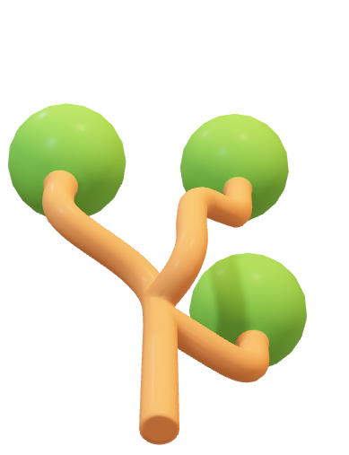
What is Git?
Git
Git is a version control system that lets you track changes in your files over time.

Slide 13

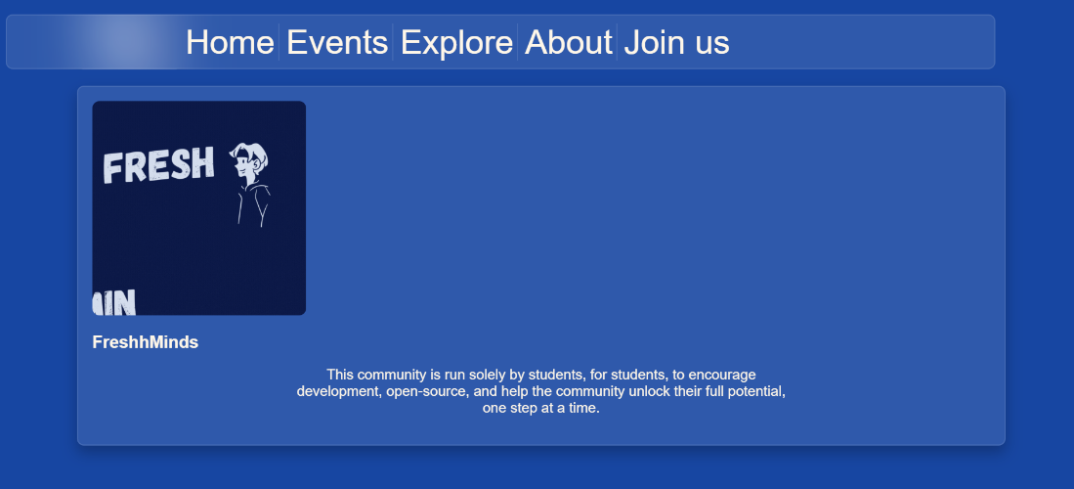
Oops! 😐

Slide 14


Oops! 😐

Slide 15
Rollback

Slide 16
Rollback

Slide 17
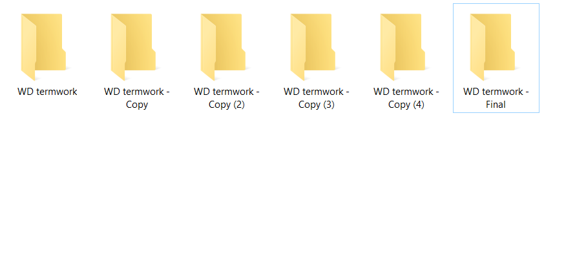

Slide 18
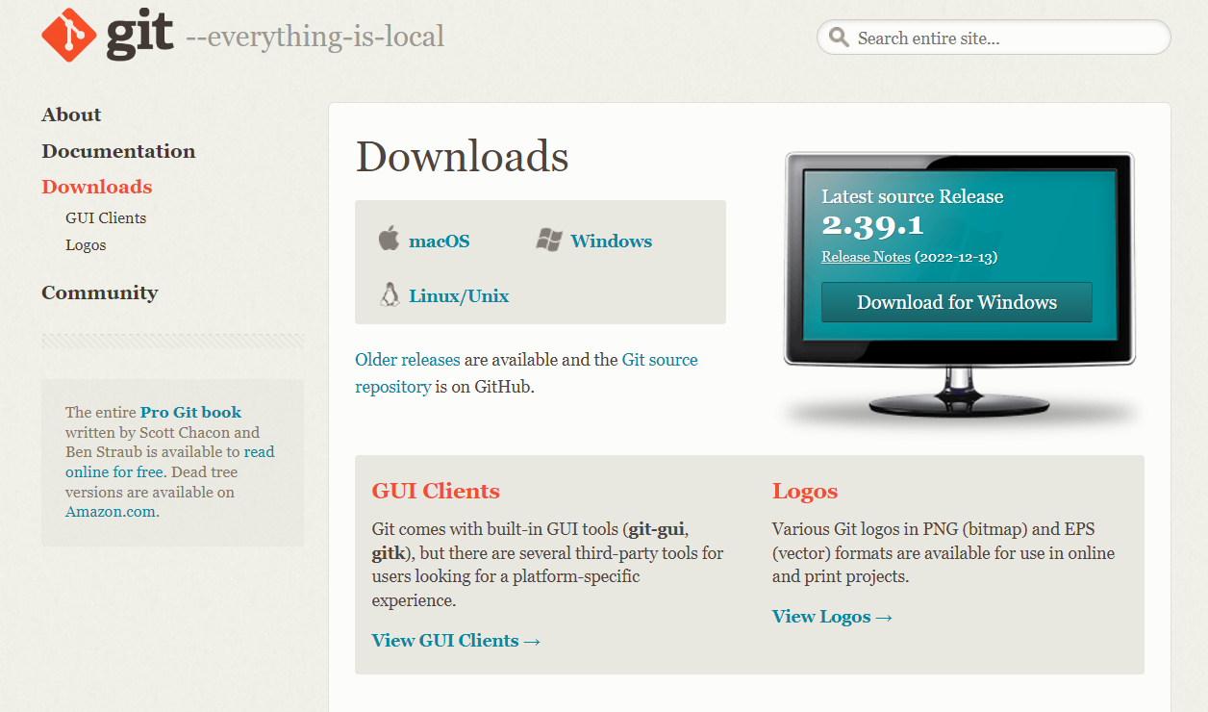
Git
INSTALLATION
https://git-scm.com/downloads

Slide 19
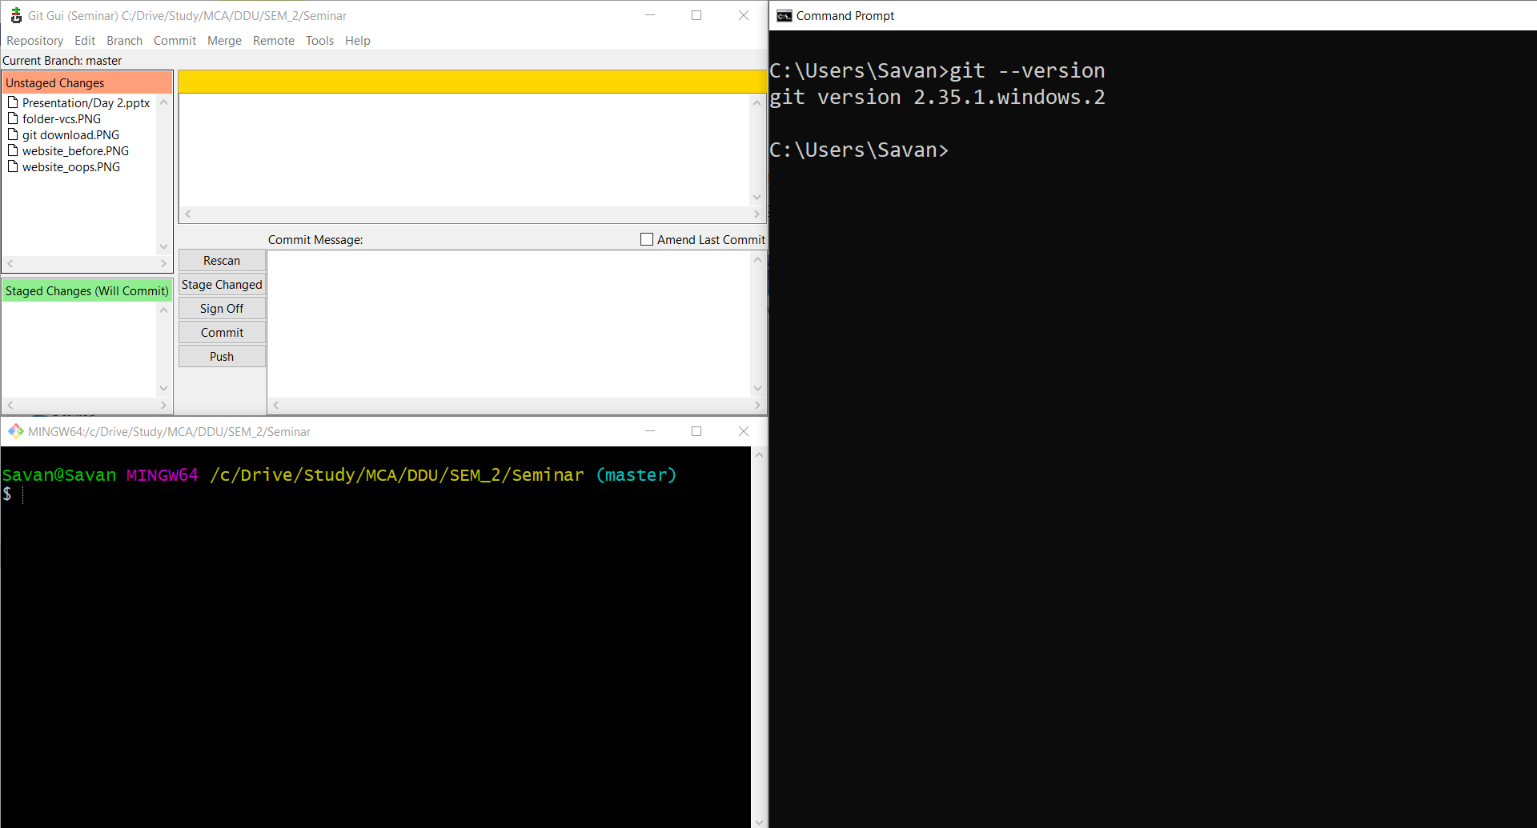
INSTALLATION
Git GUI
Command prompt
Git Bash
https://git-scm.com/downloads

Slide 20
INSTALLATION
Git GUI
Command prompt
Git Bash

Slide 21
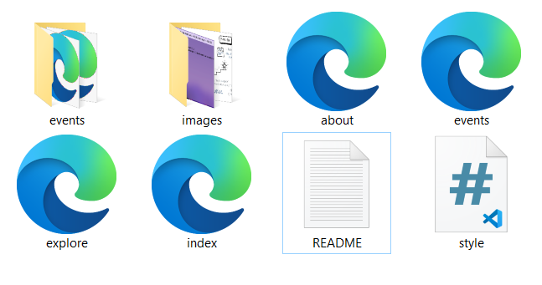
Project Folder(Working Directory)

Slide 22
Savan@Savan MINGW64 /c/Drive/TermWork/Website
$ git init
Initialized empty Git repository in C:/Drive/TermWork/Website/.git/
Git Bash

Slide 23
Savan@Savan MINGW64 /c/Drive/TermWork/Website
$ git init
Initialized empty Git repository in C:/Drive/TermWork/Website/.git/
Savan@Savan MINGW64 /c/Drive/TermWork/Website (master)
$ ls
README.txt about.html events/ events.html explore.html images/ index.html style.css
Git Bash

Slide 24
Savan@Savan MINGW64 /c/Drive/TermWork/Website (master)
$ ls
README.txt about.html events/ events.html explore.html images/ index.html style.css
Savan@Savan MINGW64 /c/Drive/TermWork/Website (master)
$ ls -a
./ .git/ about.html events.html images/ style.css
../ README.txt events/ explore.html index.html
Git Bash

Slide 25
Savan@Savan MINGW64 /c/Drive/TermWork/Website (master)
$ ls -l .git
1 Savan 197121 23 Jan 29 22:49 HEAD
1 Savan 197121 130 Jan 29 22:49 config
1 Savan 197121 73 Jan 29 22:49 description
1 Savan 197121 0 Jan 29 22:49 hooks/
1 Savan 197121 0 Jan 29 22:49 info/
1 Savan 197121 0 Jan 29 22:49 objects/
1 Savan 197121 0 Jan 29 22:49 refs/
Git Bash

Slide 26
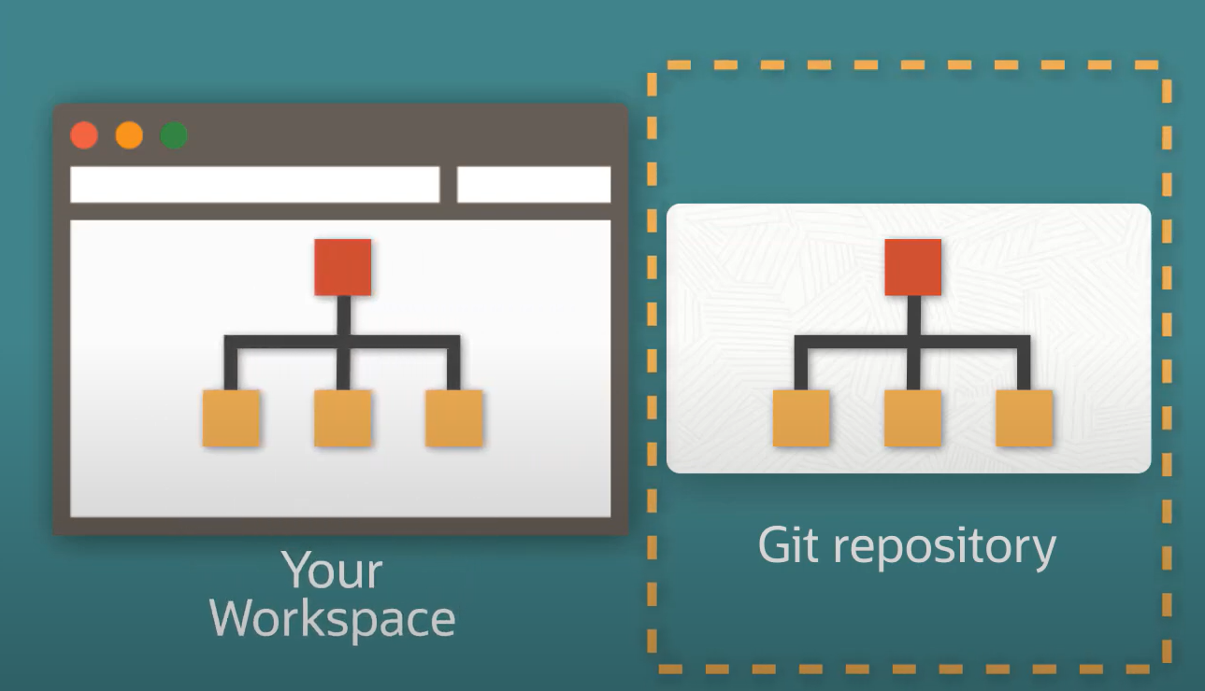
The repository is essentially the .git hidden folder inside the working directory (workspace).
The working directory (workspace) is essentially your project folder.

Slide 27
Git
Who made the Change?

Slide 28
Who made the Change?
Savan@Savan MINGW64 /c/Drive/TermWork/Website
$ git config --global user.name “Your Name”
Savan@Savan MINGW64 /c/Drive/TermWork/Website
$ git config --global user.email “youremail@domain.com”
Git Bash

Slide 29
Who made the Change?
Savan@Savan MINGW64 /c/Drive/TermWork/Website
$ git config --global user.name “Your Name”
Savan@Savan MINGW64 /c/Drive/TermWork/Website
$ git config --global user.email “youremail@domain.com”
Savan@Savan MINGW64 /c/Drive/TermWork/Website
$ git config --global –list
user.email=savanpatel5248@gmail.com
user.name=Savan Sutariya
Git Bash

Slide 30
Git
How to save a Change?

Slide 31
Repository and Working Directory

Slide 32
Savan@Savan MINGW64 /c/Drive/TermWork/Website
$ git init
Initialized empty Git repository in C:/Drive/Study/MCA/DDU/SEM_2/Seminar/Demo_TODO/.git/
Savan@Savan MINGW64 /c/Drive/TermWork/Website
$ touch README.MD
Repository and Working Directory

Slide 33
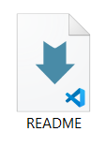
Savan@Savan MINGW64 /c/Drive/TermWork/Website
$ git init
Initialized empty Git repository in C:/Drive/Study/MCA/DDU/SEM_2/Seminar/Demo_TODO/.git/
Savan@Savan MINGW64 /c/Drive/TermWork/Website
$ touch README.MD
Repository and Working Directory

Slide 34
Empty
Savan@Savan MINGW64 /c/Drive/TermWork/Website
$ git init
Initialized empty Git repository in C:/Drive/Study/MCA/DDU/SEM_2/Seminar/Demo_TODO/.git/
Repository and Working Directory
Savan@Savan MINGW64 /c/Drive/TermWork/Website
$ touch README.MD

Slide 35
Git
Git states

Slide 36

Staging area
Empty
Untracked
Stage files
Commit
Remove the file
Untracked

Slide 37
Staging area
Empty
Untracked
Stage files
$ git add README.MD
Commit
Staging area
Remove the file

Slide 38
Empty
Untracked
Staging area
Commit
Stage files
Commit
Remove the file
Staging area

Slide 39
Empty
Untracked
Staging area
Commit
Stage files
$ git commit –m “Initial commit”
Commit
Remove the file
Commit

Slide 40
Untracked
Staging area
Git repository
Stage files
Commit
Commit made

Slide 41
Untracked
Staging area
Git repository
Stage files
Commit
Commit

Slide 42
Untracked
Staging area
Git repository
Stage files
Commit
Commit

Slide 43
Untracked
Staging area
Git repository
Stage files
Commit
Remove the file
Commit

Slide 44
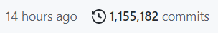
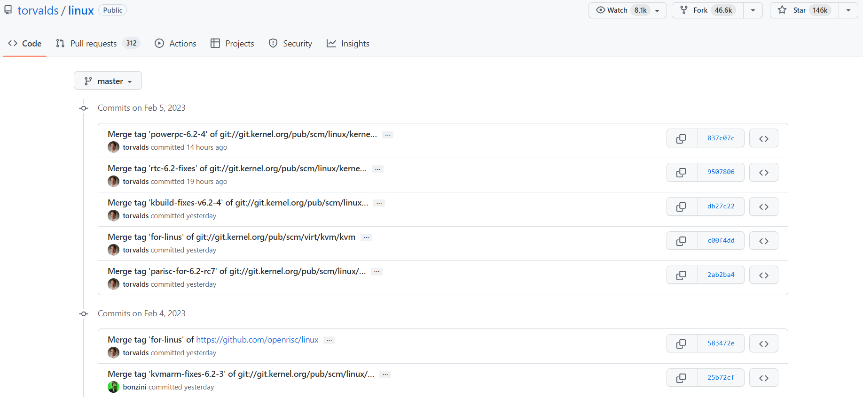
Untracked
Staging area
Git repository
Stage files
Commit
Commit log of linux

Slide 45
Untracked
Staging area
Git repository
Stage files
Commit
Commit log of linux

Slide 46
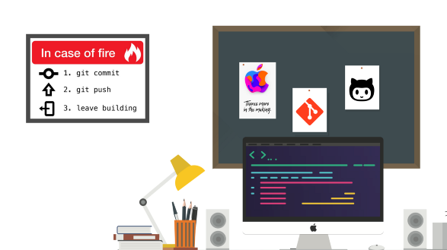

Slide 47
Git
Basic Commands

Slide 48
Git
Basic Commands
$ git init
$ git add
$ git commit

Slide 49
Git
Basic Commands
$ git init
$ git add
$ git commit
$ git commit
$ git status

Slide 50
Git
$ git status
Displays the state of the working directory and the staging area.
It lets you see which changes have been staged, which haven’t, and which files aren’t being tracked by Git.
Basic Commands

Slide 51
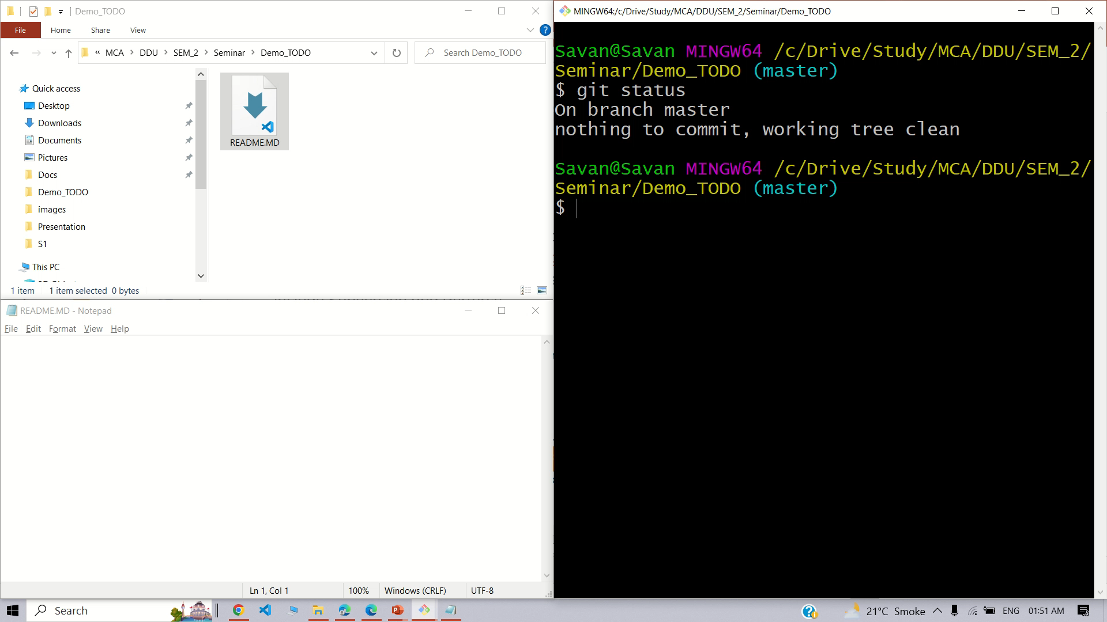
Git
$ git status
Any changes that have been made to files in the repository
Any files that have been added to the repository but have not yet been committed
Any files that have been removed from the repository but not yet deleted from the file system
Any files that have been deleted from the file system but not yet removed from the repository
Any files that have been modified and staged for commit
Basic Commands

Slide 52
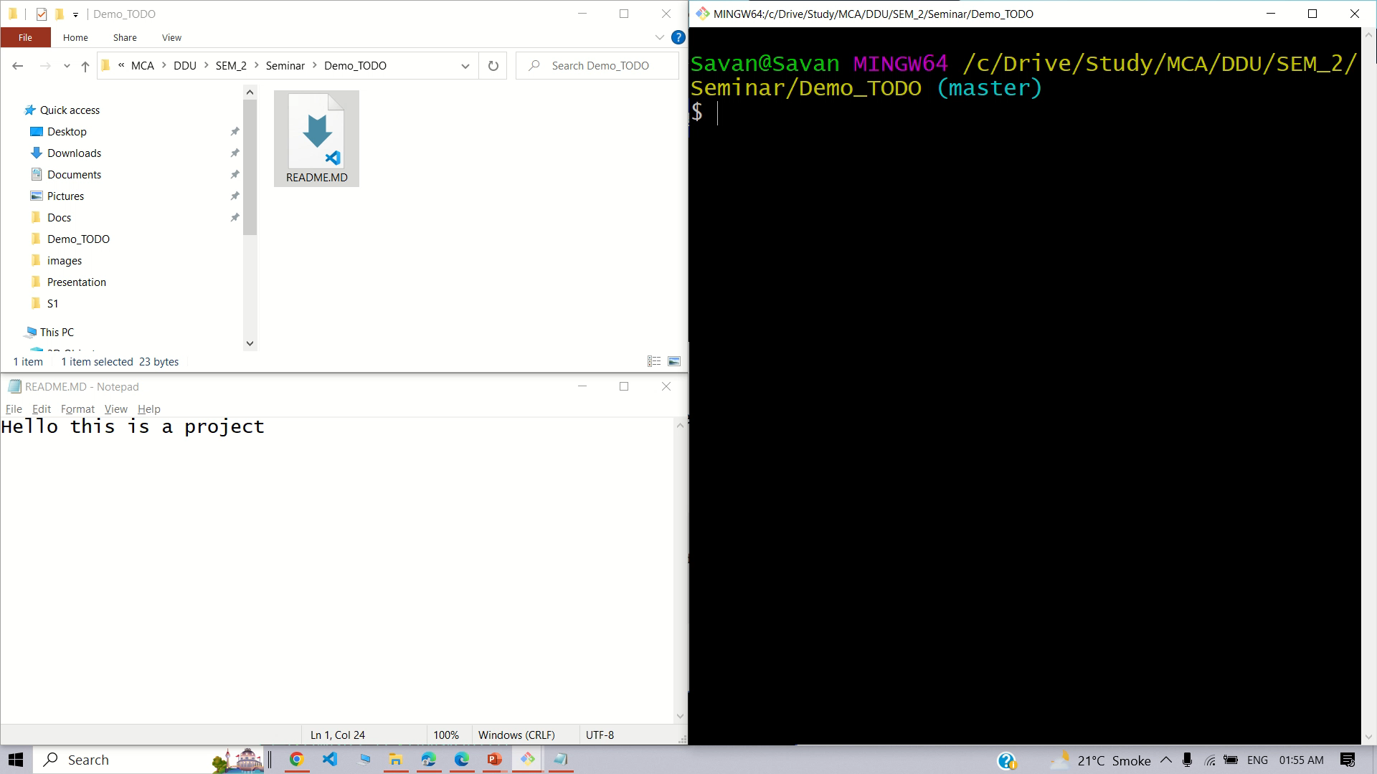
Git
$ git status
Any changes that have been made to files in the repository
Any files that have been added to the repository but have not yet been committed
Any files that have been removed from the repository but not yet deleted from the file system
Any files that have been deleted from the file system but not yet removed from the repository
Any files that have been modified and staged for commit
Basic Commands

Slide 53
Git
Basic Commands
$ git init
$ git add
$ git commit
$ git commit
$ git status

Slide 54
Git
Basic Commands
$ git init
$ git add
$ git commit
$ git commit
$ git status
$ git log

Slide 55
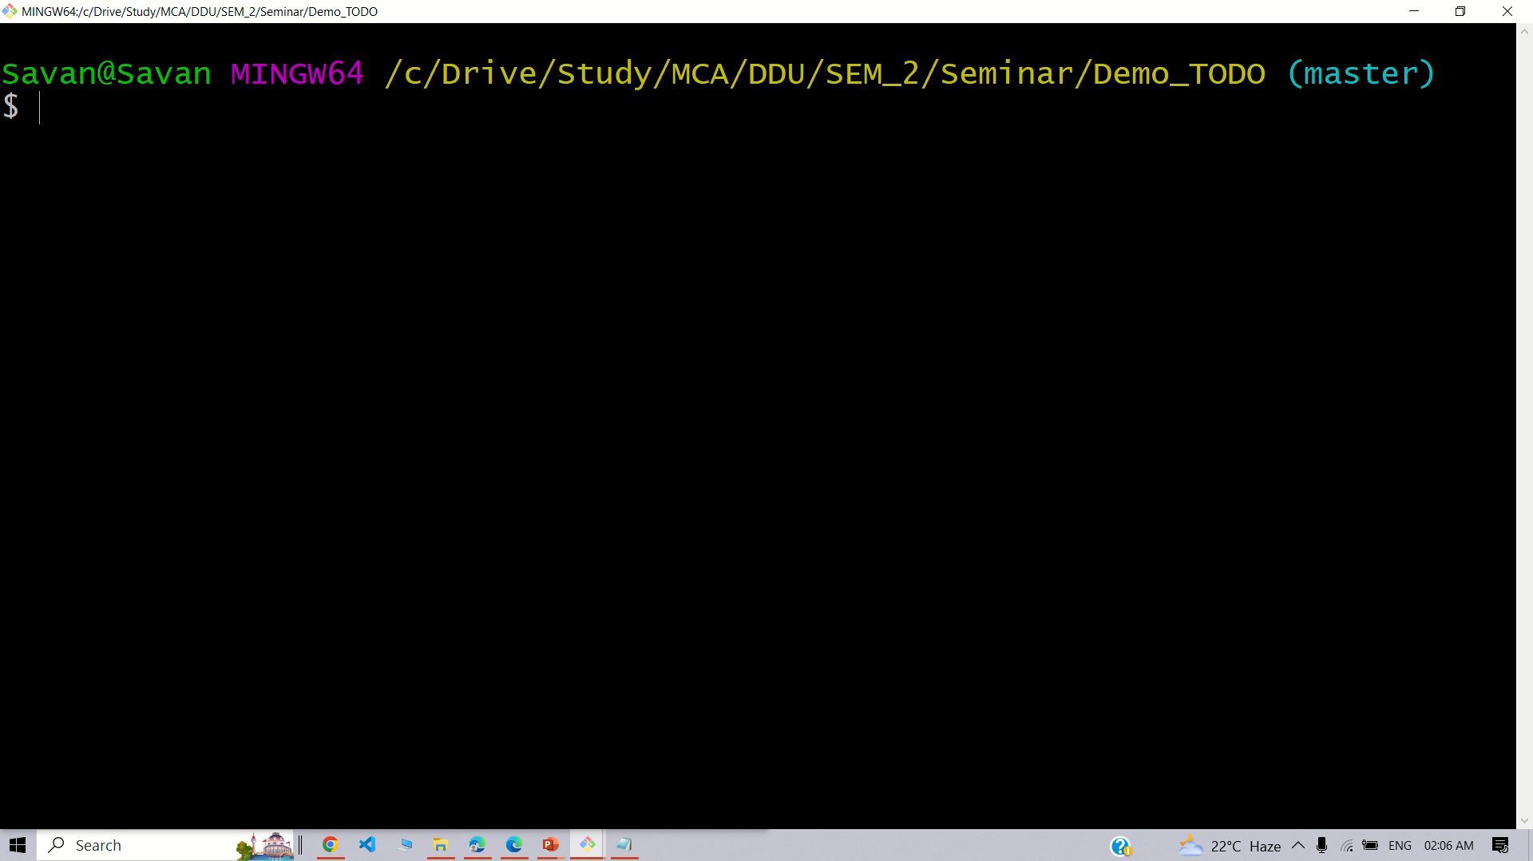
Git
$ git log
Any changes that have been made to files in the repository
Any files that have been added to the repository but have not yet been committed
Any files that have been removed from the repository but not yet deleted from the file system
Any files that have been deleted from the file system but not yet removed from the repository
Any files that have been modified and staged for commit
Basic Commands

Slide 56
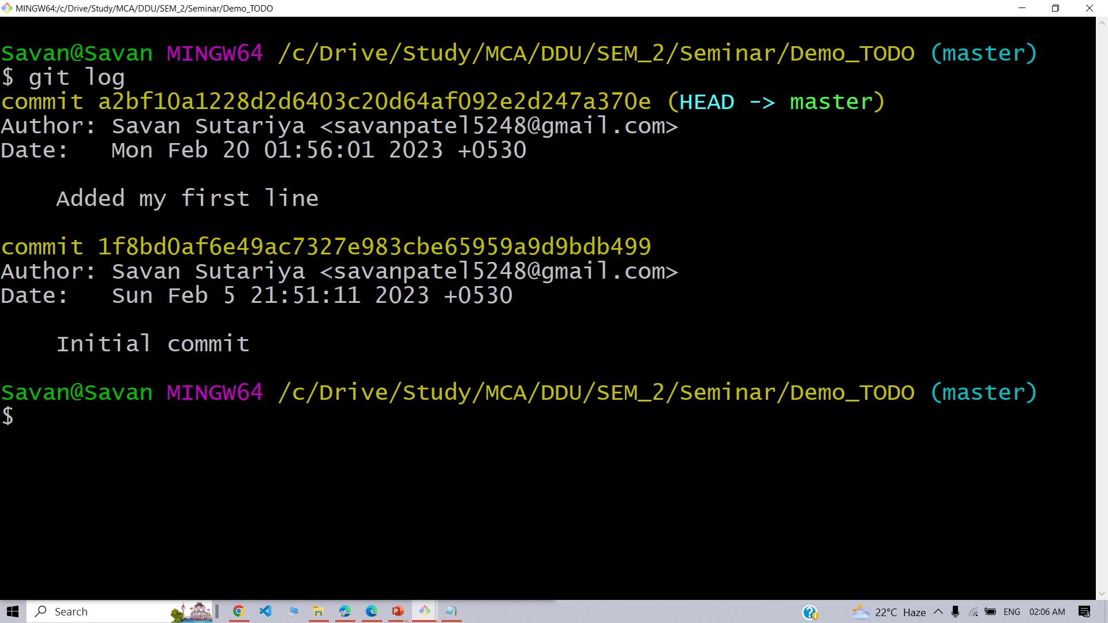
Git
$ git log
Basic Commands

Slide 57
Git
Use of
.gitignore

Slide 58
Git
Add files to Staging area
$ git add README.MD

Slide 59
Add files to Staging area
$ git add README.MD
$ git add index.html
$ git add style.css
.
.
.
$ git add .

Slide 60
Git
Call everyone to the Stage
Everyone come on the stage
$ git add .
$ git add README.MD
$ git add index.html
$ git add style.css
.
.
.

Slide 61
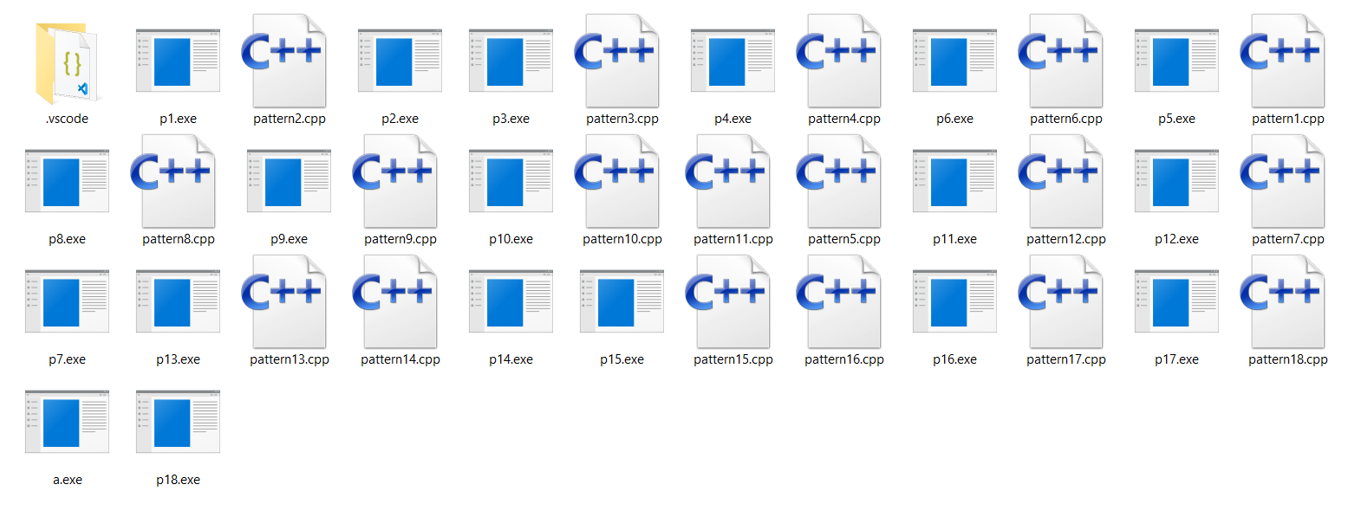
Git
Call everyone to the Stage
Everyone come on the stage
$ git add .
$ git add README.MD
$ git add index.html
$ git add style.css
.
.
.

Slide 62
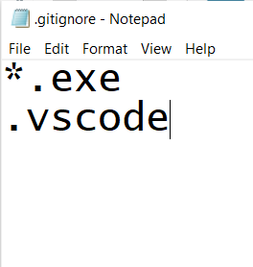
Git
Call everyone to the Stage
Everyone come on the stage
Except these
$ git add .
.gitignore
$ git add README.MD
$ git add index.html
$ git add style.css
.
.
.

Slide 63
Git
(Unstaged) Changes
Undo changes

Slide 64
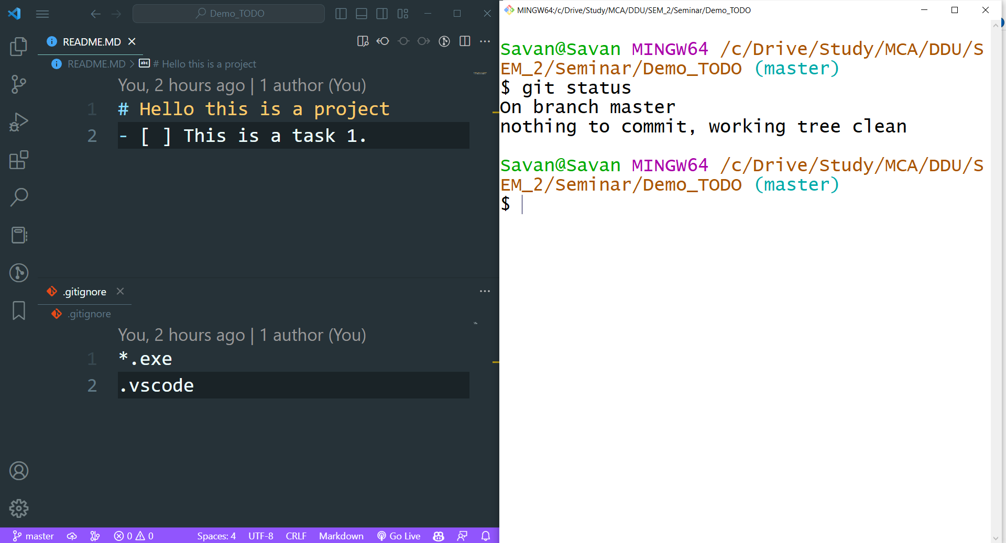
Git
Clean working directory

Slide 65
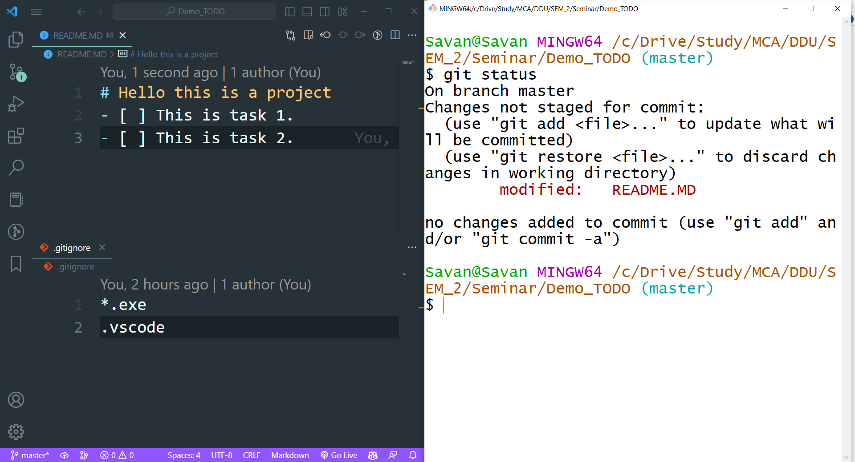
Git
A new task in TODO

Slide 66
Git
$ git restore
git restore is a command that helps you undo changes you made to files or recover deleted files in a Git project.
Basic Commands

Slide 67
Git

Slide 68
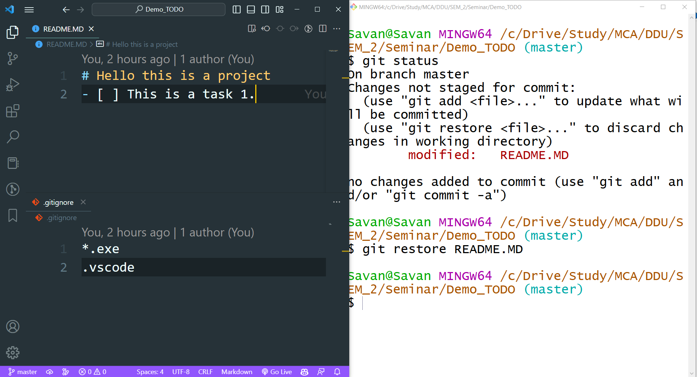
Git
Restored

Slide 69
Git
(Staged) Changes
Undo changes

Slide 70
(Staged) Changes
Git
Step1: Unstage the file
$git restore --staged
Undo changes

Slide 71
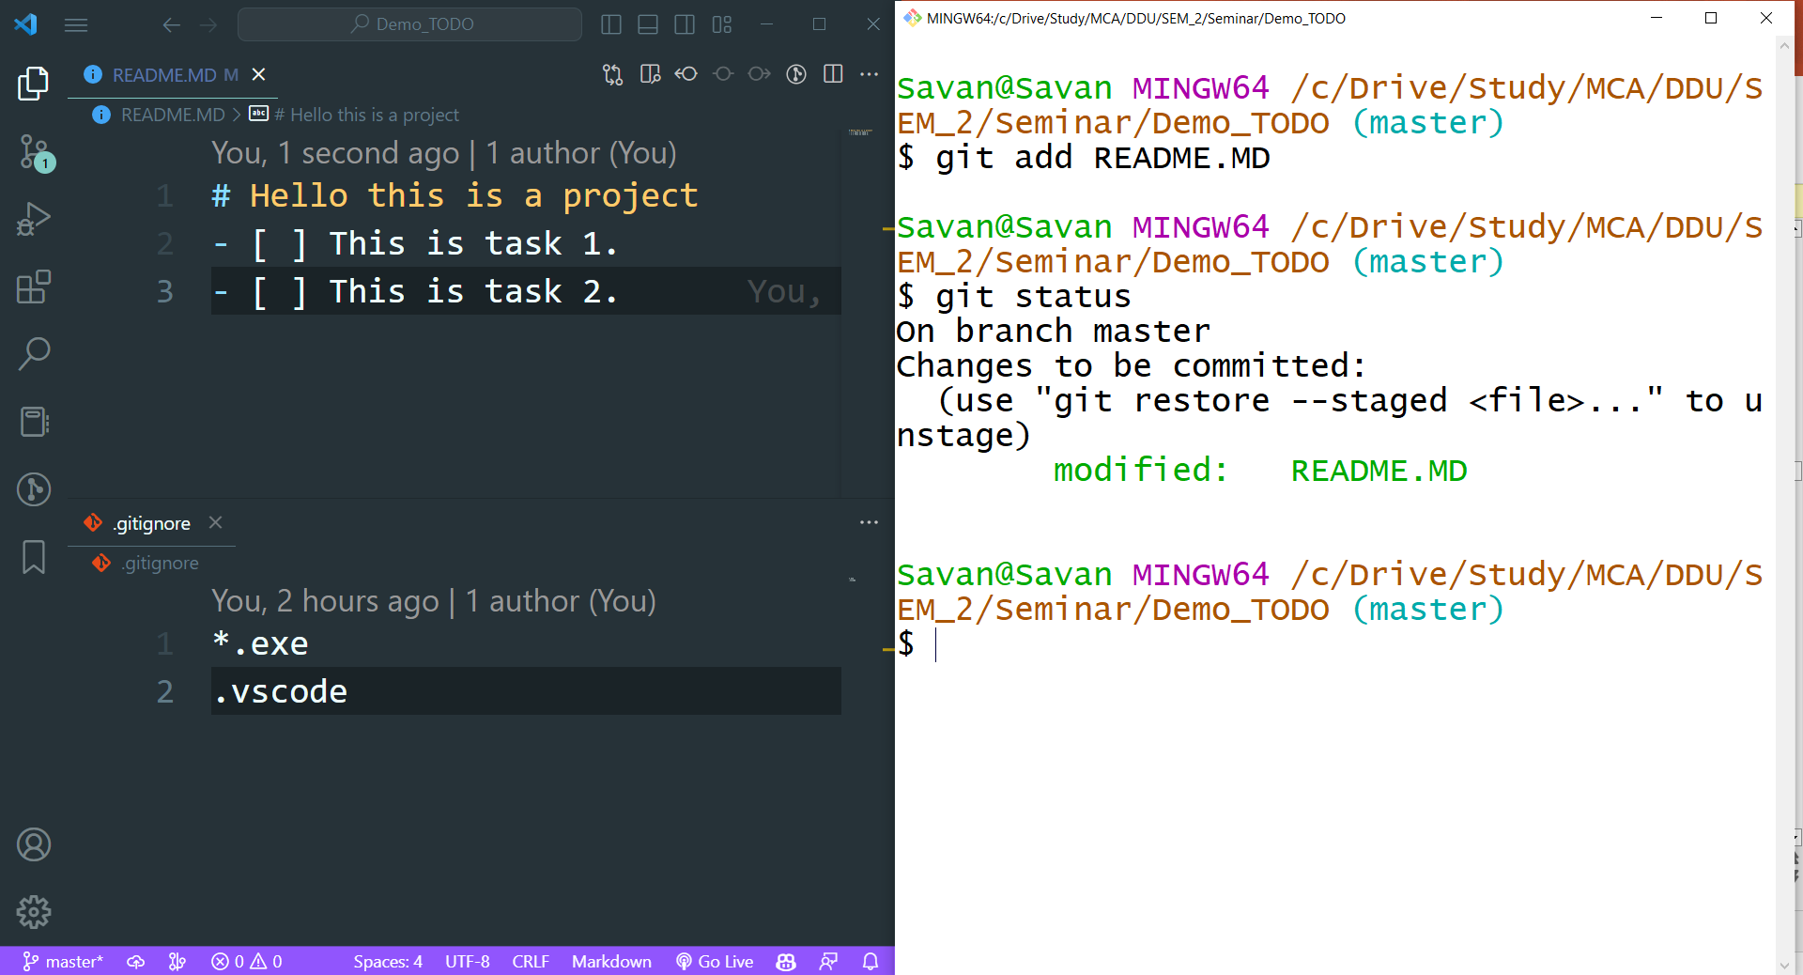
Git
A changed file is on stage

Slide 72
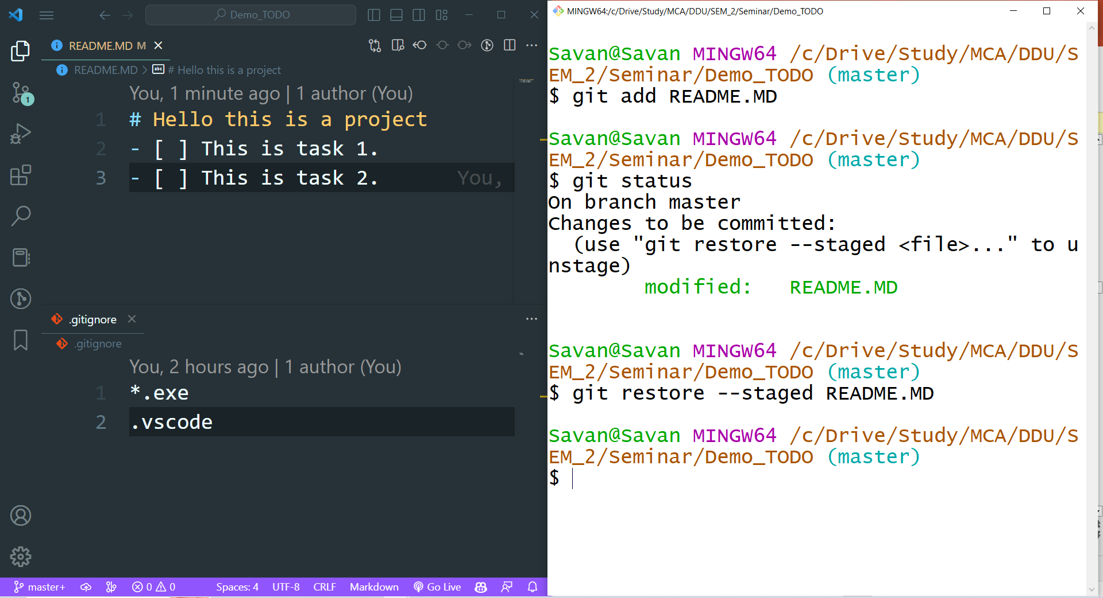
Git
Unstaged the file

Slide 73
(Staged) Changes
Git
Step1: Unstage the file
Step2: restore the change
Undo changes

Slide 74
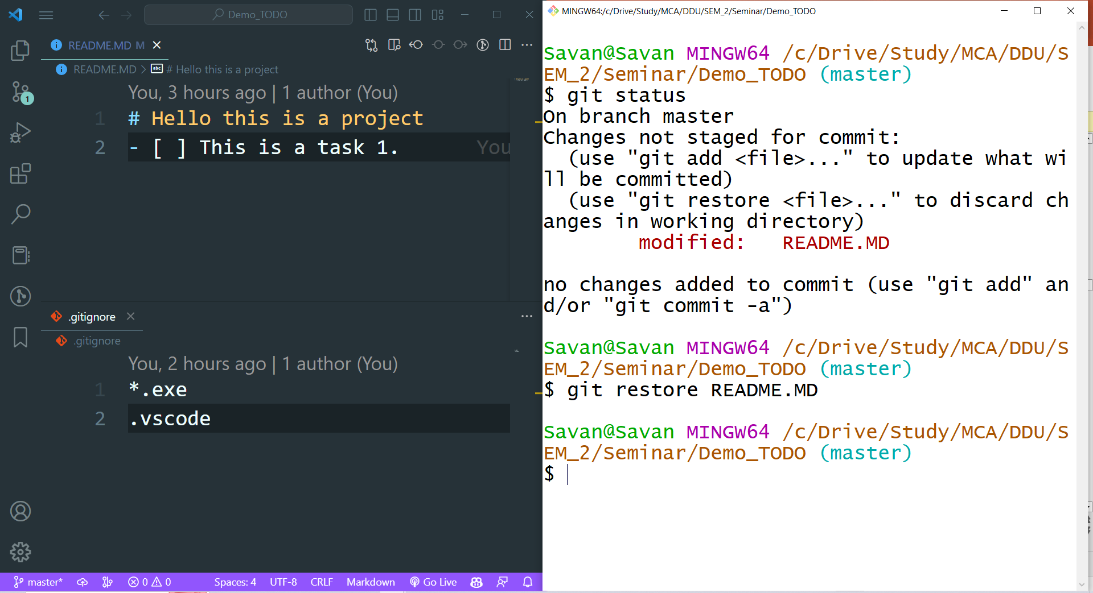
Git
Restored

Slide 75
Git
(Commited) Changes
Undo changes

Slide 76
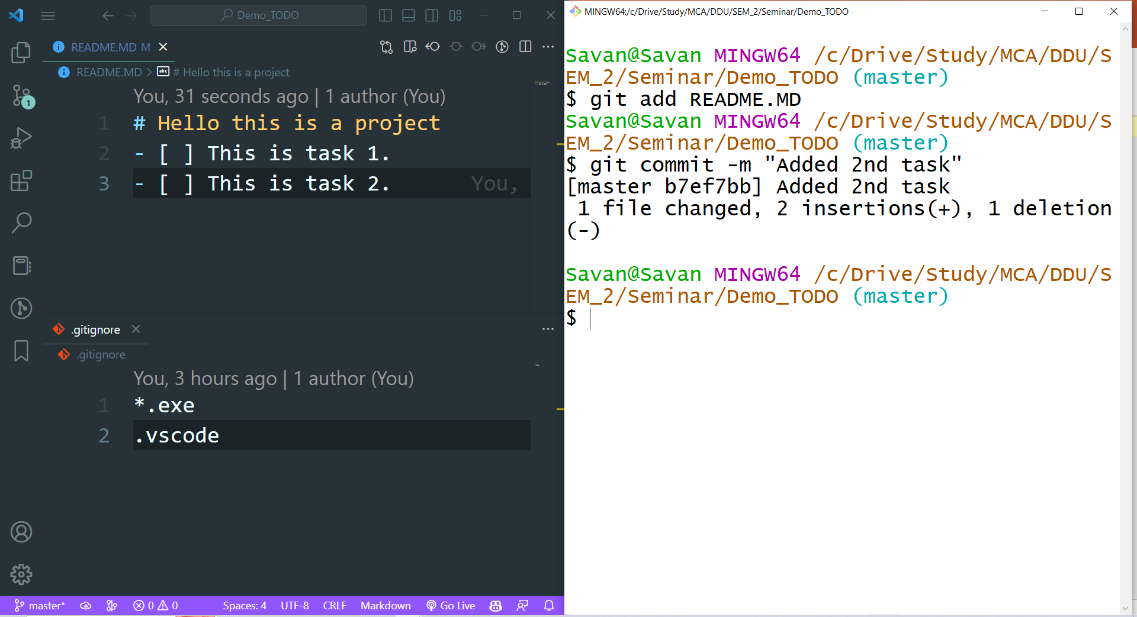
Git
Added 2nd task
Committed a change

Slide 77
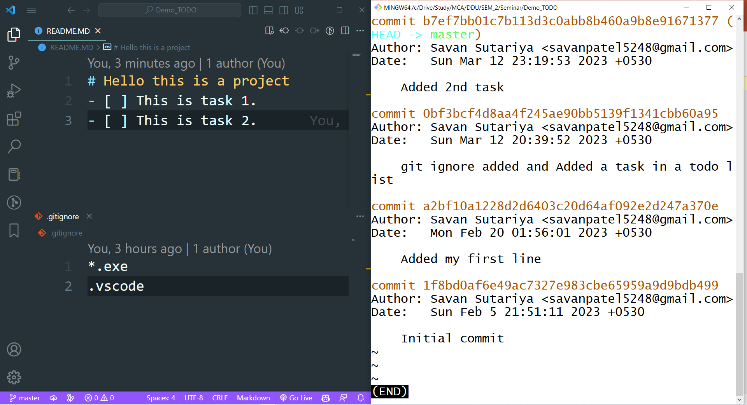
Git
Commit log

Slide 78
Git

Slide 79
(Commited) Changes
Git
git reset --hard HEAD~1
Undo changes

Slide 80
Git
$ git reset
You can use it to move the current branch to a specific commit, or even remove a commit entirely. However, be careful when using this command as it can cause data loss or create inconsistencies in the repository's history.
Basic Commands

Slide 81
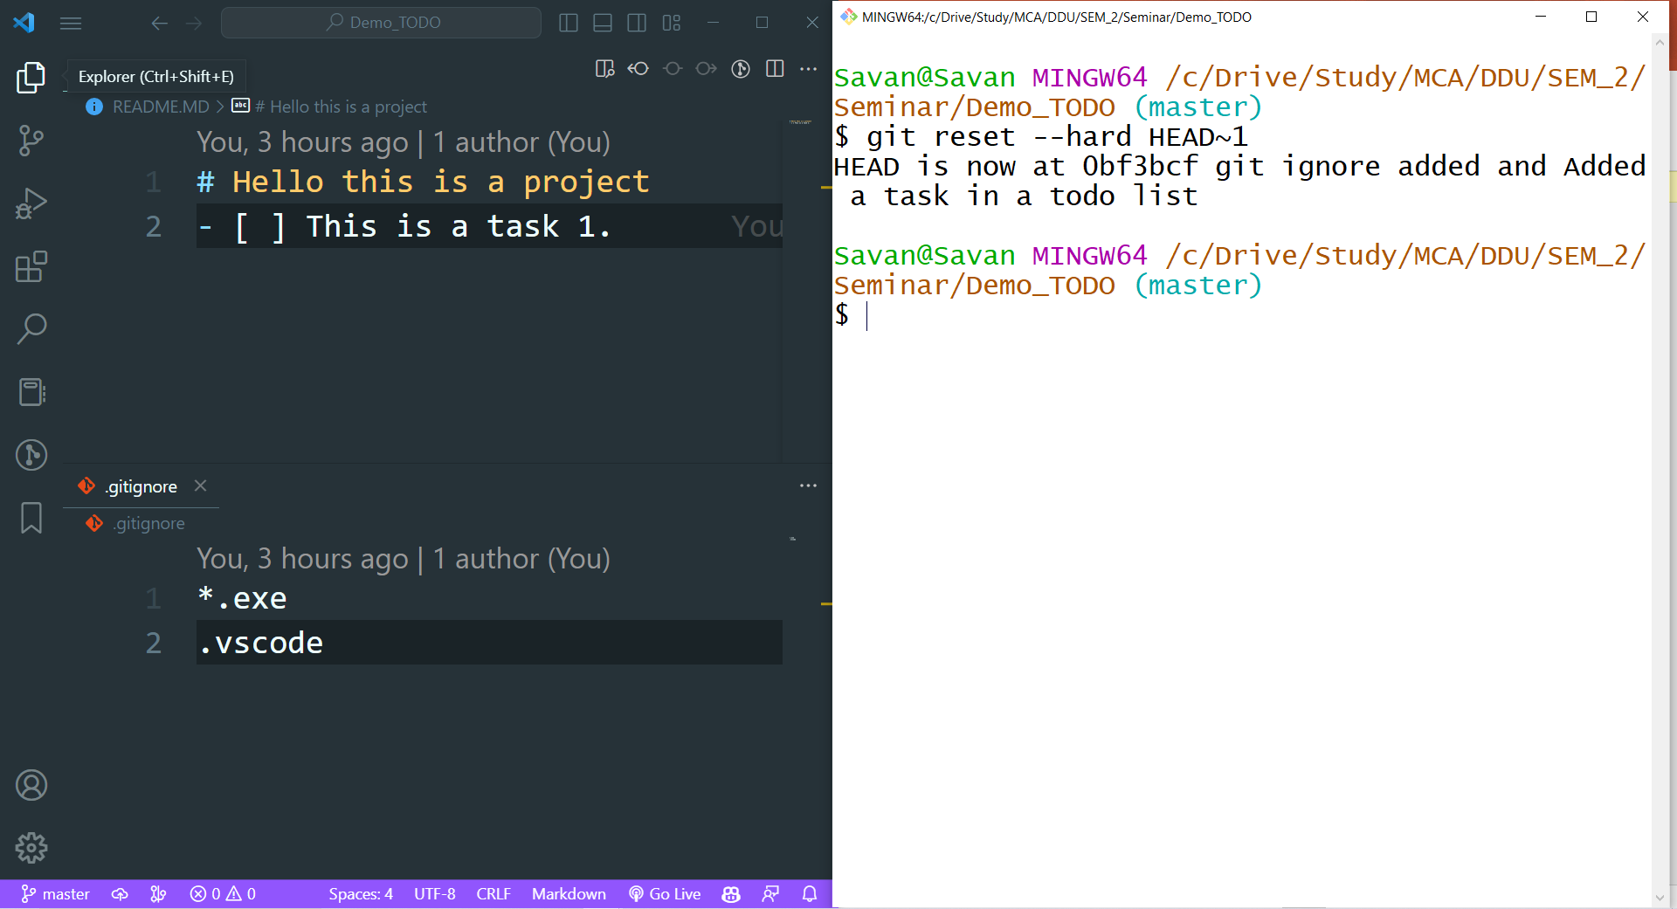
Git
Reset

Slide 82
Git
Progress..
$ git init
$ git add
$ git commit
$ git status

Slide 83
Git
Progress..
$ git init
$ git add
$ git commit
$ git status
$ git restore
$ git reset

